Slide 1
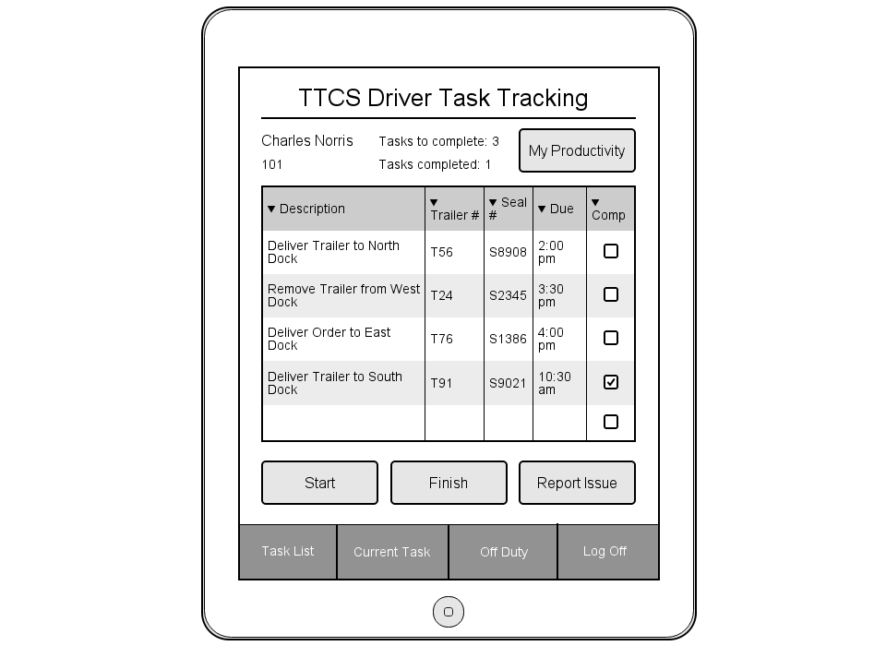
Task List View
Main Screen for app
Daily statistics with personalized information
Grid with list of today’s tasks. Shows information necessary to begin a task.
Start a task from this view, finish it, or Report an issue identified before beginning.
Menu options for switching views, going off duty or logging off.

Slide 2
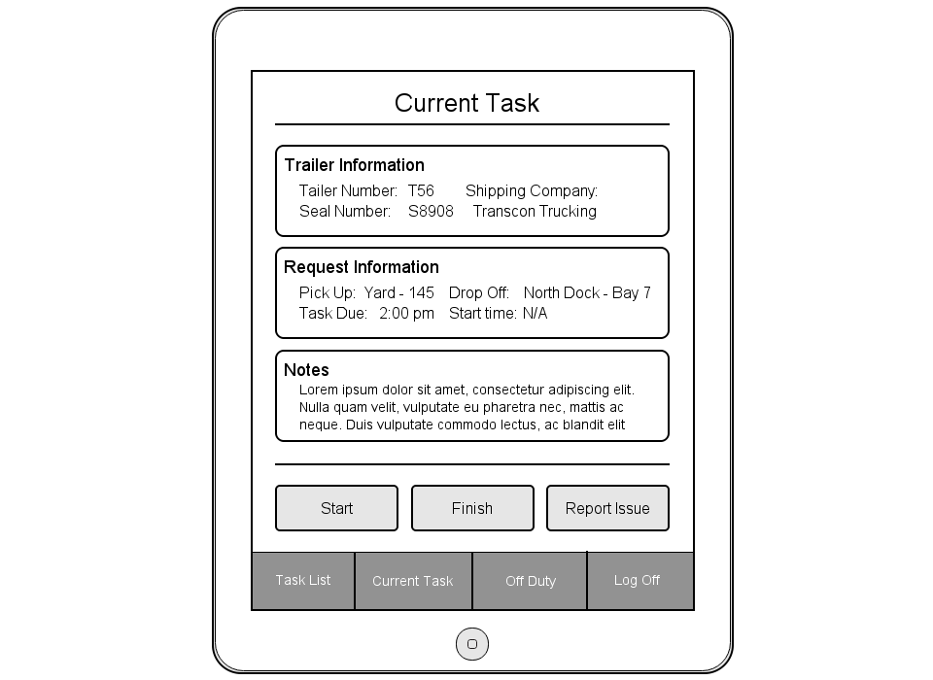
Current Task View
Trailer Information displays information necessary to identify the trailer needed for this request
Request information displays the details of the request; when and where you need to be
Notes contains any additional notes added by either Dock Foreman or Dispatcher
Finish your task from here or Report an issue on it.
Menu options

Slide 3
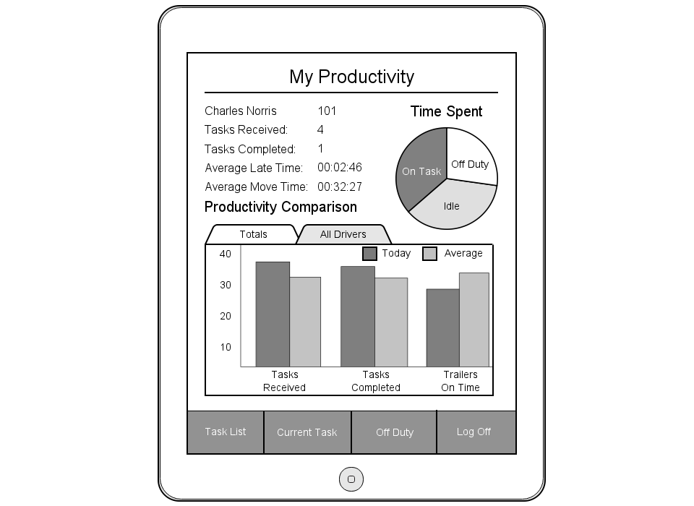
My Productivity
Personalized information
Daily statistics for trailer deliveries
Pie chart depicting how the driver is spending his/her time
Bar chart displaying the driver’s daily stats in comparison to the averages of all drivers for that day
Menu options

Slide 4
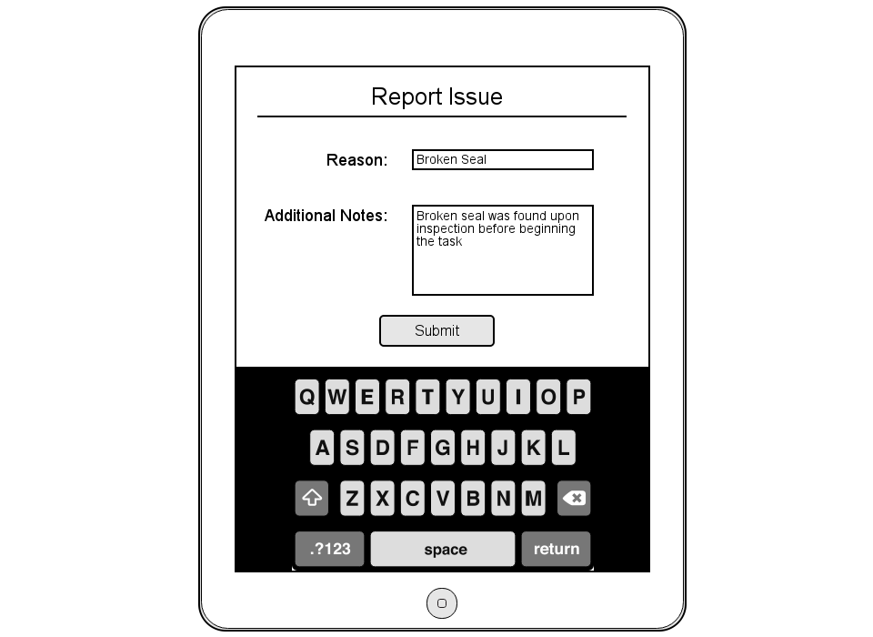
Report Issue
‘Reason’ field to give a name to your reported issue (i.e. Broken Seal)
Additional notes field to add anything the dispatcher might need to know
Sends entered information to dispatcher along with current task information

Slide 5
Executive Summary
What was the task?
Major Issues Identified with the current system
Break down in communication causing inefficiencies
Lack of reporting
Unnecessary manual processes
Lack of accountability
What we'll be covering

Slide 6
Costs
Cost Category | Total Cost
Labour | $156,580
Material | $19,06.7
Hardware | $24,939.98
Total Costs | $183,426.68

Slide 7
Benefits
Benefit Category | Total Savings (per year)
Labour | $120,960
Business | $167025
Total Savings | $835,125

Slide 8

Return on Investment
Year 0 | Year 1 | Year 2 | Year 3 | Year 4 | Year 5
-183,426.68 | 145,239.13 | 126,294.90 | 109,821.65 | 95,497.09 | 83,040.94
-183,426.68 | -38,187.55 | 88,107.35 | 197,929.00 | 293,426.08 | 376,467.03

